Slide 1
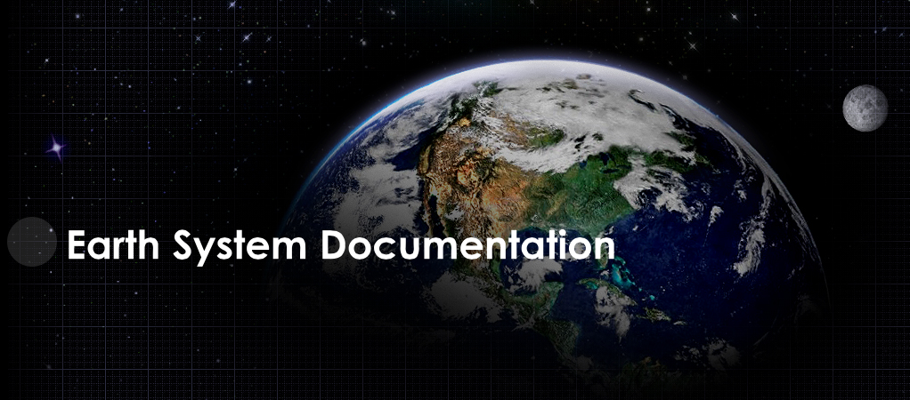


Slide 2
http://es-doc.org

Slide 3
#esdocumentation

Slide 4
Funders
IPSL
NOAA
EX-ARCH (G8)

Slide 5
PI’s
Venkatramani Balaji (NOAA)
Cecelia DeLuca (NOAA)
Sébastien Denvil (IPSL)
Eric Guilyardi (IPSL)
Bryan Lawrence (BADC)
Karl Taylor (PCMDI)

Slide 6
Core Team
Sylvia Murphy (NOAA)
Allyn Treshansky (NOAA)
Mark Greenslade (IPSL)

Slide 7
Mission
Nurture a standards based eco-system in support of earth system documentation creation, analysis & dissemination.

Slide 8
eco-system progress 2013

Slide 9
Git Repo’s 2012
esdoc-api
esdoc-js-client
esdoc-mp
esdoc-splash

Slide 10
Git Repo’s 2013
esdoc-api
esdoc-deploy
esdoc-js-client
esdoc-django-cim-forms
esdoc-docs
esdoc-shell
esdoc-splash
esdoc-mp
esdoc-py-client

Slide 11
Tools 2012
viewer

Slide 12
Tools 2013
search
viewer
comparator
questionnaire

Slide 13
API 2012
search

Slide 14
API 2013
search
publish
compare

Slide 15
Projects 2012
cmip5
dcmip-2012

Slide 16
Projects 2013
cmip5
dcmip-2012
qed-2013
cordex

Slide 17
Demos
CI
Deploy
Tools: Search, Compare
API: Publish

Slide 18
demos

Slide 19
2014
Statistical downscaling
Real time documentation publishing
More comparators
CORDEX documentation

